Slide 1

Final Capstone
Joel Taylor, Joseph Larkin , & Maureen Kennedy
Coppertones Cybersecurity Group

Slide 2
Goals & Objectives
Our goal is to perform a grey box vulnerability scan of BBank customer portal using IP: http://192.168.10.161/cyberwarrior/.
We will then use this information to potentially gain access to the system to exploit various vulnerabilities that we come across.
Afterwards provide our findings and recommendations to strengthen and remediate any potential security flaws.

Slide 3
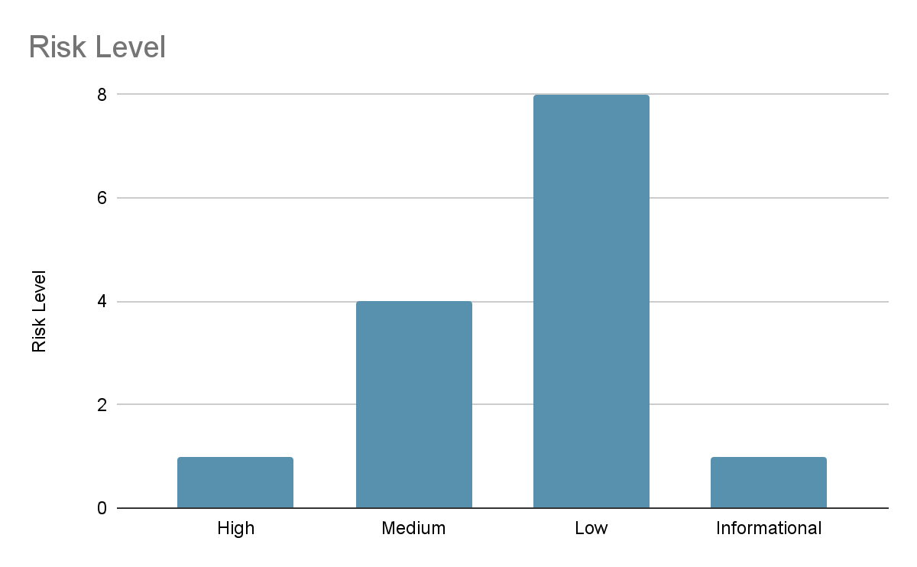
Executive Summary
In Scope
BBank Web Application
Tools:
Nmap
Hydra
OWASP ZAP
SQL MAP
OpenVAS Greenbone
Nikto
Notes:
nmap to scan open ports
hydra for brute force
owasp zap and openvas and nikto to scan for vulnerabilities
sqlmap for injection attack

Slide 4
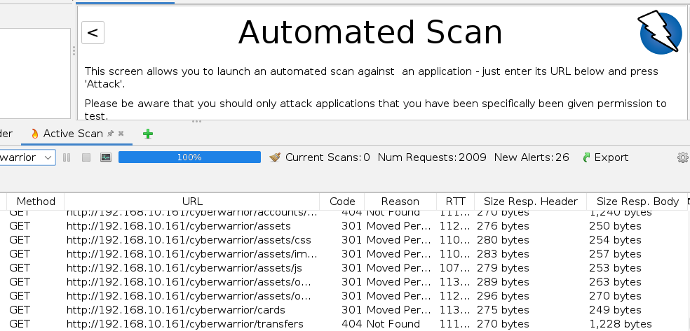
OWASP ZAP
OWASP ZAP is used to scan websites for potential vulnerabilities. Our initial reconnaissance started with a ZAP scan of the BBank web application. We were quickly able to determine there was a potential SQL injection vulnerability. Afterwards we decided to begin our pen test with an injection attack using SQLMap.

Slide 5
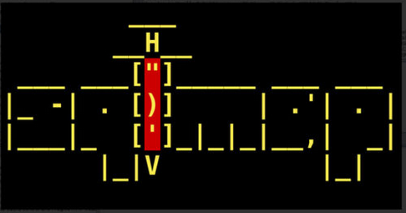
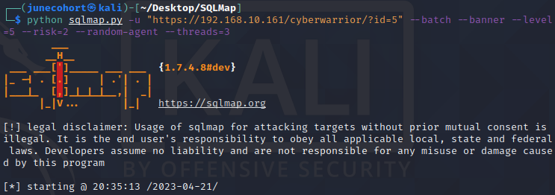
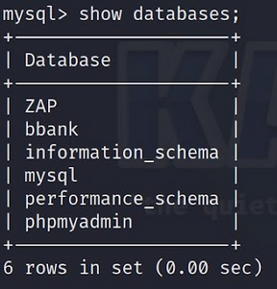
SQLMap is a tool used for SQL injection attacks and reconnaissance. After discovering a possible SQL vulnerability, we ran an SQL Injection attack using SQLMap. The command in the image to the right was initially used to scout and potentially uncover sensitive data, however it was successful in disabling databases on the BBank web application. After the databases came back online, We were able to browse them freely in conjunction with other tools that will be outlined shortly.

Slide 6
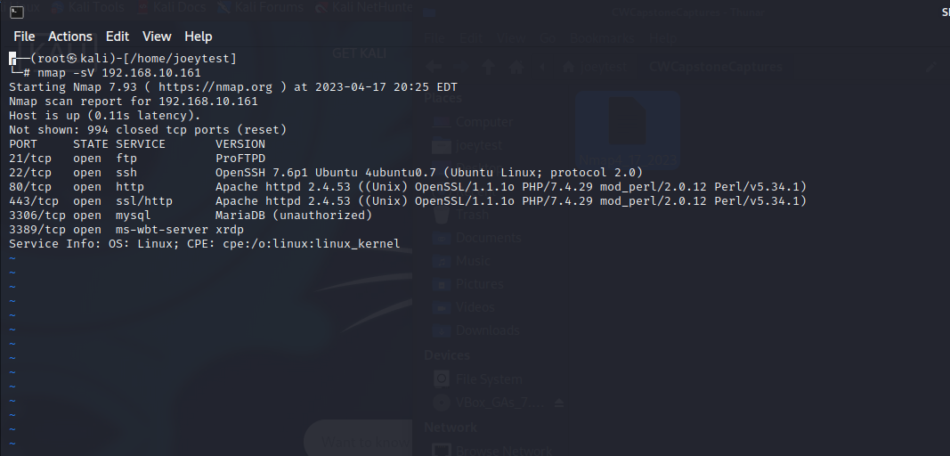
Nmap
Nmap, short for Network Mapper, is a free and open source tool used for vulnerability checking, port scanning and, of course, network mapping. Despite being created back in 1997, Nmap remains the gold standard against which all other similar tools, either commercial or open source, are judged.
We used Nmap -sV (-sV is an OS scan which sends TCP and UDP packets to a particular port before analyzing its response). As you can see from the results we were able to show a number of open and vulnerable ports along with the OS version. Having this knowledge gives us great insight on potential attack vectors.

Slide 7

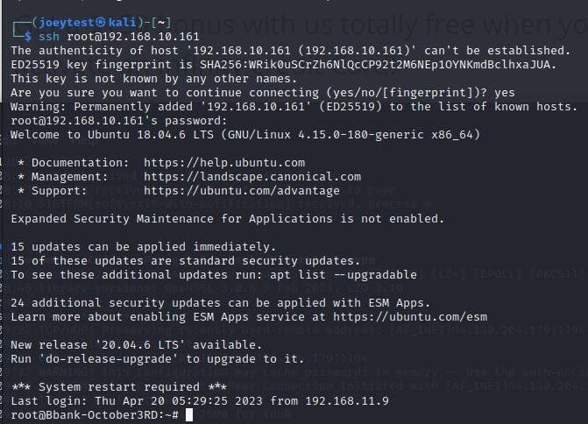
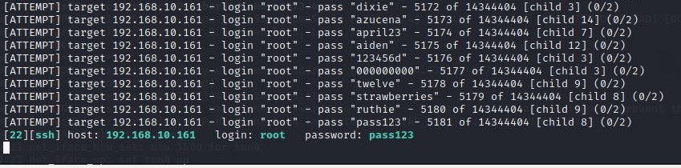
Hydra
We used hydra with great success for brute forcing FTP and SSH access.
Default/Common usernames and passwords
You're only as good as your username and password lists. But, Id say patience is the ultimate test.
Notes:
Hydra is a brute-forcing tool that helps penetration testers and ethical hackers crack the passwords of network services. Hydra can perform rapid dictionary attacks against more than 50 protocols. This includes telnet, FTP, HTTP, HTTPS, SMB, databases, and several other services
Cmd ran$ sudo hydra -l user -P /usr/share/wordlists/rockyou.txt 192.168.10.161 ftp

Slide 8
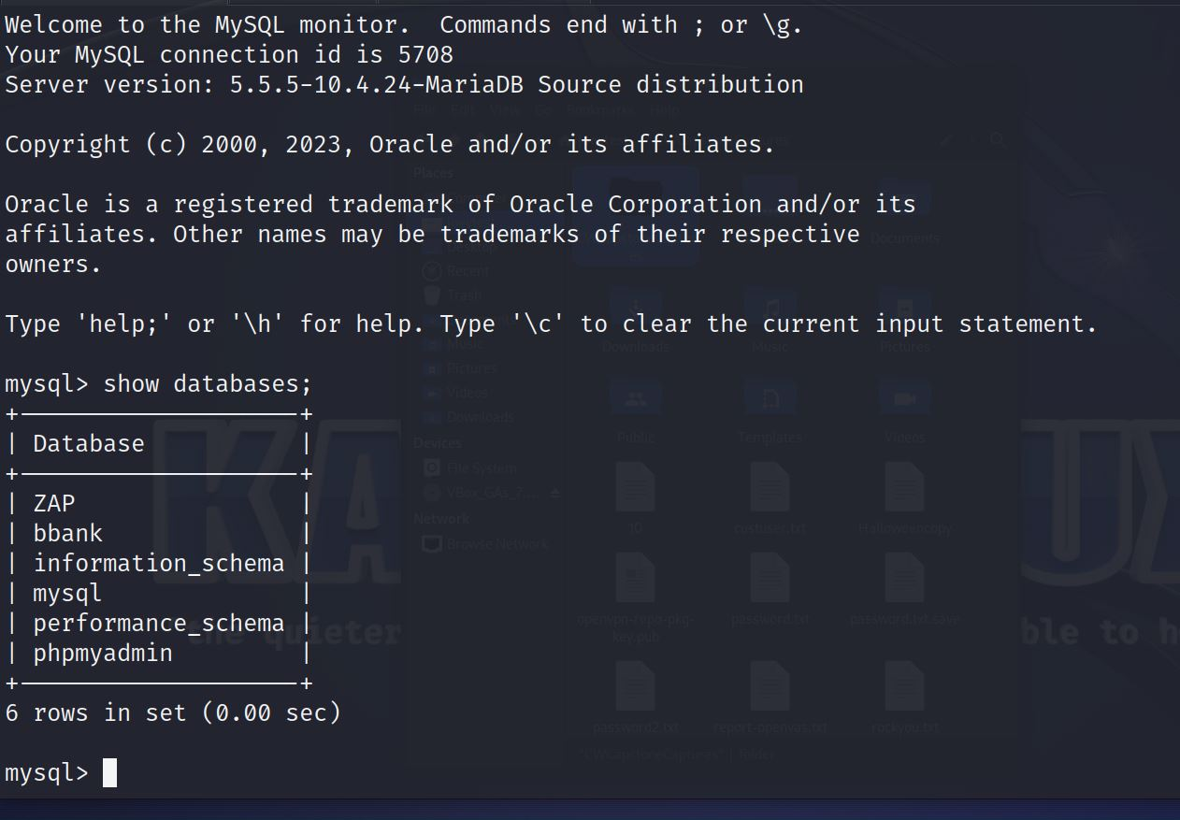
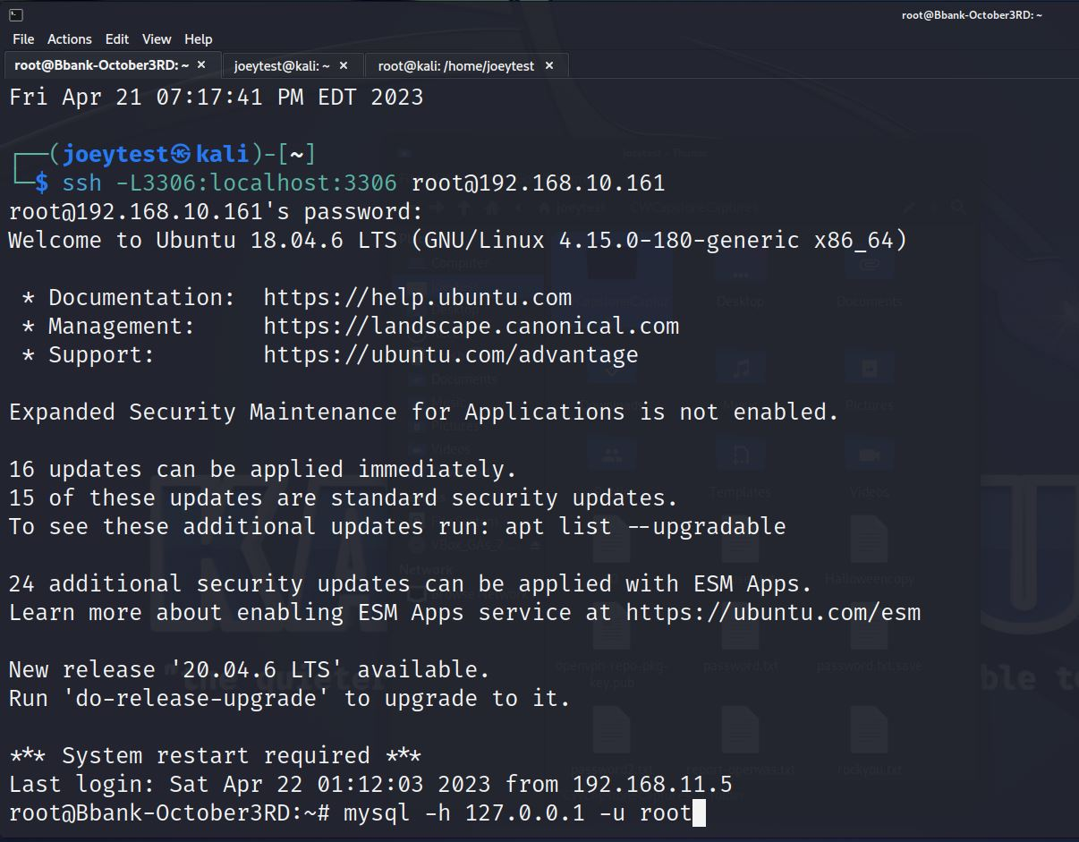
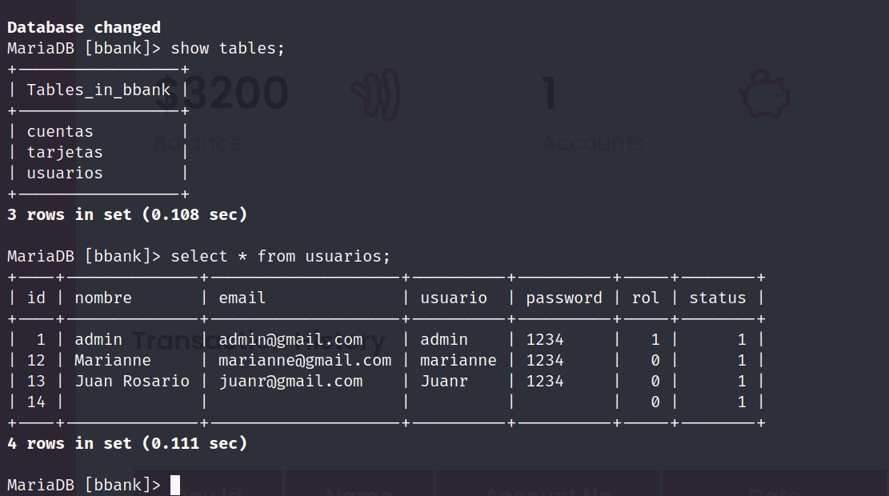
Accessing the DB
Having root SSH access we were able to access the database using mysql on our local machine. We were able to browse the different tables and extract key information to gain entry into BBank user portal with the admin account.

Slide 9
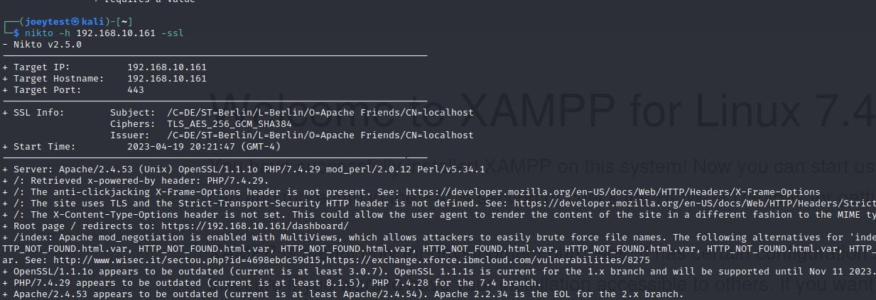
Nikto
Nikto is a free software command-line vulnerability scanner that scans webservers for dangerous files/CGIs, outdated server software and other problems. It performs generic and server type specific checks. It also captures and prints any cookies received
We can see Apache is running on OpenSSL 1.1.1 which has many vulnerabilities. One being to allow an attacker to read memory contents or enact a denial of service.
Undefined headers: the X-Frame-Options HTTP header field indicates a policy that specifies whether the browser should render the transmitted resource within a frame or an iframe. Servers can declare this policy in the header of their HTTP responses to prevent clickjacking. Clickjacking is when an attacker uses multiple transparent or opaque layers to trick a user into clicking on a button or link on a framed page when they were intending to click on the top level page.

Slide 10

Video Demonstration

Slide 11
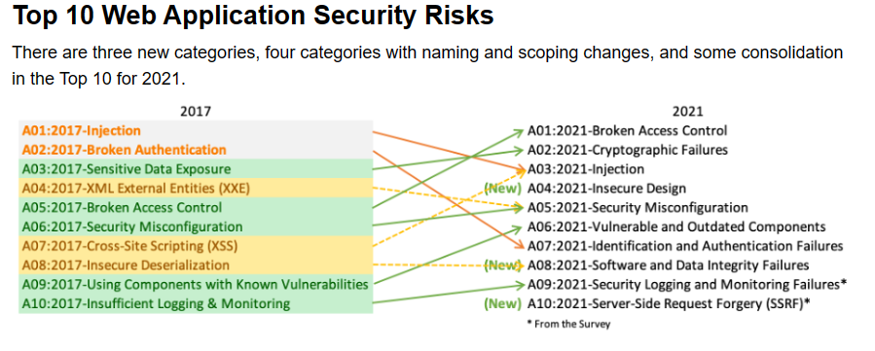
OWASP Top Ten & BBank Top Risks
BBank Top Potential Risks:
SQL Injection
SSL/TLS: Certificate Expired
Phishing & Spear Phishing

Slide 12
Risk & Recommendations
SQL Injections
Risk High - (CWE:89)
The impact of this vulnerability is far reaching. A successful attack may result in the unauthorized viewing of user lists, the deletion of entire tables and the attacker could possible obtain administrative rights to the database.
Recommendations:
Do not trust client side input, even if there is client side validation in place. All data on the server side should be type checked.
If BBank decides to use JDBC, they should use Prepared Statements or Callable Statement, with parameters passed by ‘?’.
If BBank decides to use ASP, they should use ADO Command Objects with strong type checking and parameterized queries.
Do not link strings into queries in the stored procedure, or use ‘exec’, exec immediate, or equivalent functionality.
Do not create dynamic SQL queries using simple string links.
Apply an ‘allow list’ of allowed characters or a ‘deny list’ of disallowed characters in user input.
Apply the principle of least privilege by using the least privileged database user possible.
Avoid using the ‘sa’ or ‘db-owner’ database users.
These recommendations do not eliminate SQL injection, but minimizes its impact. Grant the minimum database that is needed for the application.

Slide 13
Risks & Recommendations OWASP Cont.
SSL/TLS: Certificate Expired
Risk: Medium
The remote server's SSL/TLS certificate has already expired. This means clients cannot verify your website. It also means it is not in compliance with the latest security standards, making the encryption vulnerable to attack.
Recommendation:
Replace the SSL/TLS certificate.
Review & maintain all certificates.

Slide 14
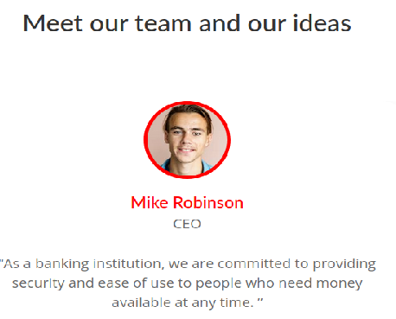
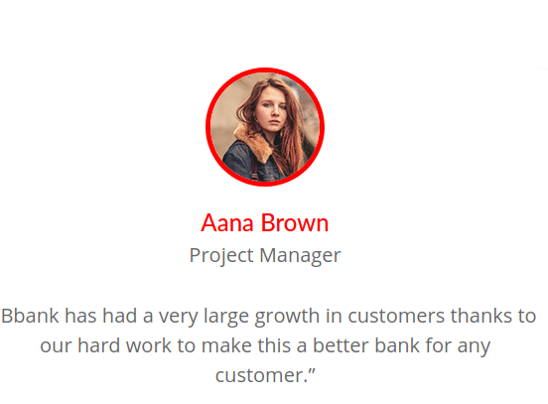
Phishing & Spear Phishing
Phishing - fraudulent emails looking to obtain sensitive information
Spear Phishing - targets specific individuals or groups within an organization.
Recommendations:
Be aware of unusual emails.
Do not click or open any attachments or links from unknown sources.
Block email addresses that are malicious.
Back up data.
Use Multi-factor authentication (MFA)

Slide 15
In Closing
BBank must ensure an ongoing plan for monitoring, triaging, and applying updates and configuration changes for the lifetime of the application. This also means proper and consistent training for all employees. As well as proper review with clients on how to keep their account information confidential to prevent possible data breaches.
And remember, whether it’s out in the sun or in your network, you can always rely on the Coppertones!

